Slide 1
Grouping and Classifying

Slide 2
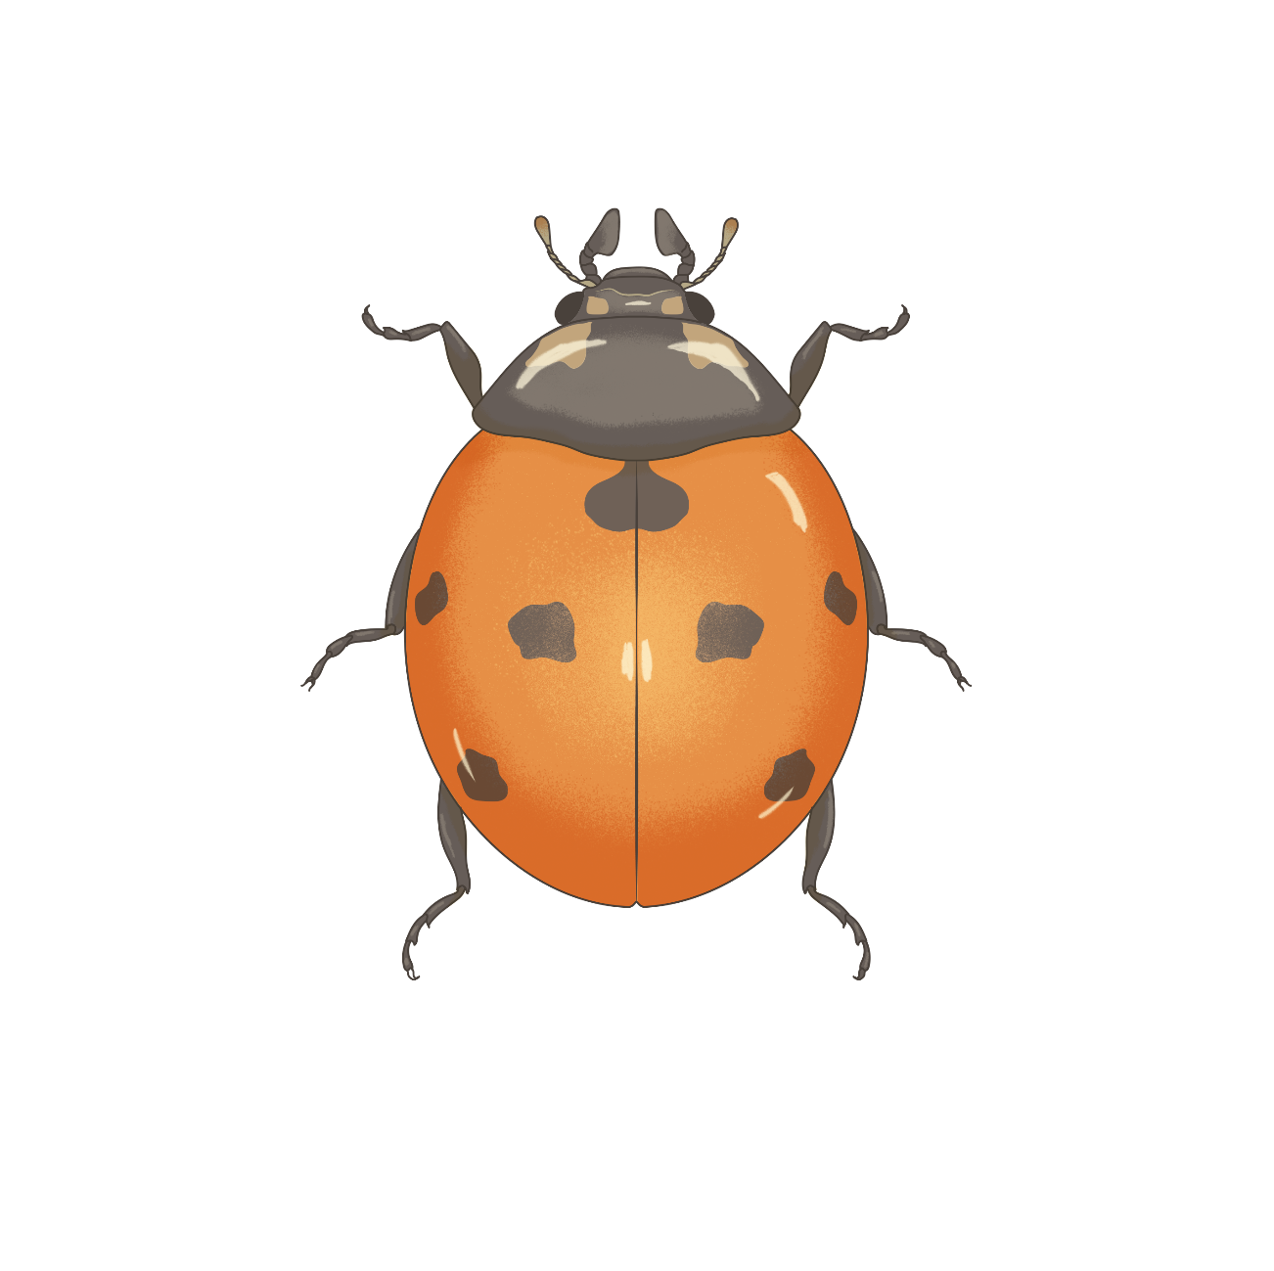
Grouping and Classifying
What is this animal?
What group does it belong to?
(Birds, insects, mammals, reptiles etc.)

Slide 3
Parts of a ladybird
Grouping and Classifying
Maxillary palp
Antenna
Head
Thorax
Legs
Abdomen
Shell/Elytra

Slide 4
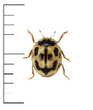
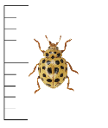
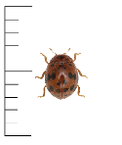
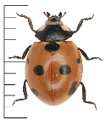
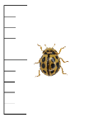
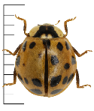
Grouping ladybirds
Grouping and Classifying
Example:
Look carefully at the ladybirds’ features.
Sort the ladybirds into groups.
Put a label on each group.
Yellow shell
Red shell

Slide 5
Grouping ladybirds
Grouping and Classifying
Example:
Try and spilt each group into smaller groups.
Give the new groups another label.
Yellow shell
Red shell
Round spots
Square spots
Bigger than 5mm
Smaller than 5mm

Slide 6
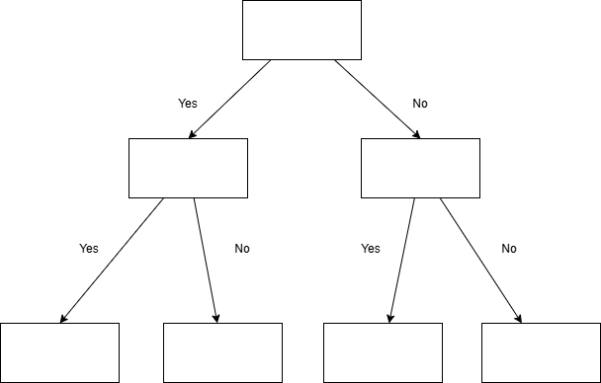
Making a branching key
Grouping and Classifying

Slide 7
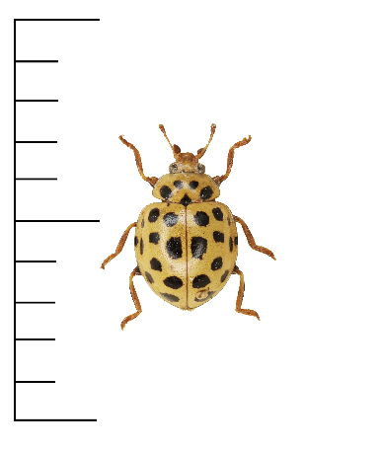
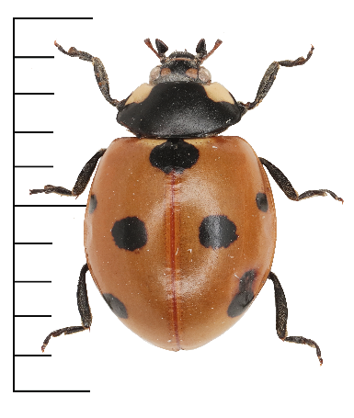
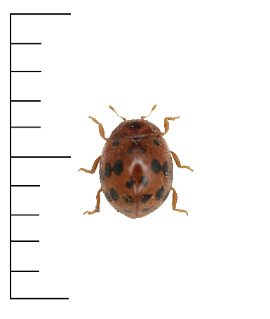
Make a branching key
Grouping and Classifying
Example:
Spread out the ladybird cards and look at their features.
Think of questions which answer ‘yes’ for some ladybirds, and ‘no’ for the rest. Write down your questions on pieces of paper.
Pick a question to be at the top. Draw arrows to show where the 'yes' and 'no' ladybirds should go.
Add another question at the end of each arrow to split the ladybirds into smaller groups until each ladybird species ends up in its own spot on the page.
Swap your key with another group and see if it works for their ladybirds.
Does it have a Yellow shell?
Yes
No
Is it smaller than 5mm
Yes
No
Notes:
If working with the ladybird sorting cards, start with the 10 marked species cards for this activity.
Use separate pieces of paper or sticky-notes for the questions so students can rearrange and experiment with the structure of their key.

Slide 8
Branching key challenge
Grouping and Classifying
Some ladybird species can have lots of different colour patterns.
Try using your branching key to identify the species of the extra ladybird cards.
Notes:
Use the 5 extra cards for this activity. Card numbers (xx – 11) to (xx – 15).
The aim of this activity is to demonstrate that there is variation within a species. With experience, scientists learn which features are less variable in each species and use these features for identification. In ladybirds this is often a combination of size, leg colour, and pattern on the thorax (the segment just behind the head).
Often scientists will need to use microscopes to inspect tiny features.
Sometimes even experienced scientists can't identify something just by looking at it and they will need to study the animal's DNA to tell species apart.

Slide 9
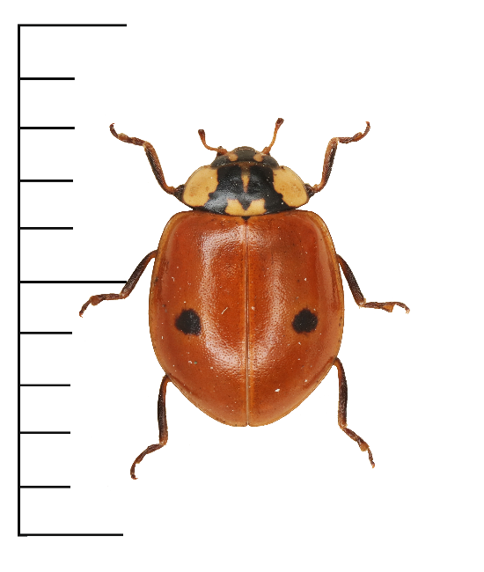
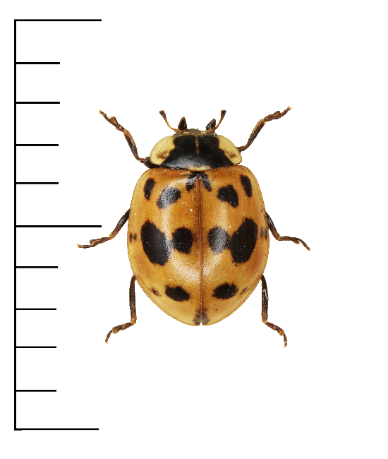
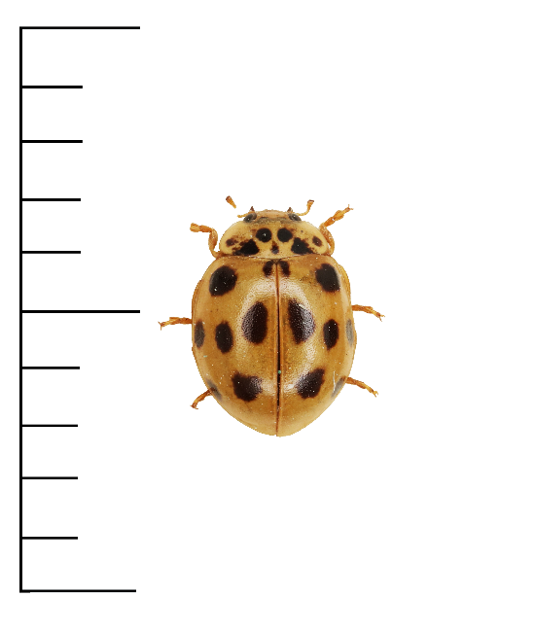
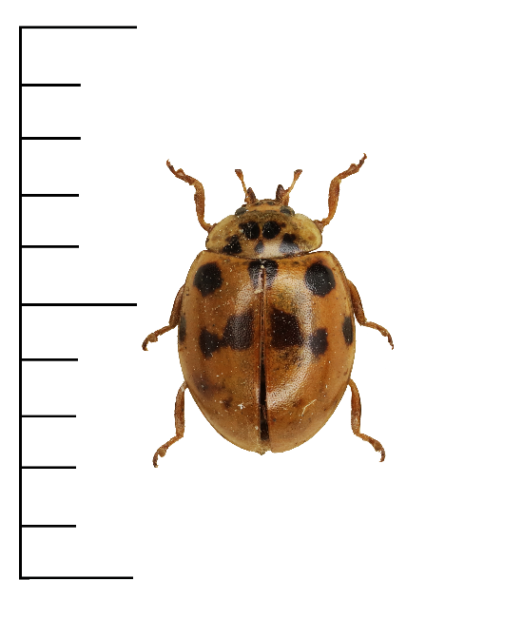
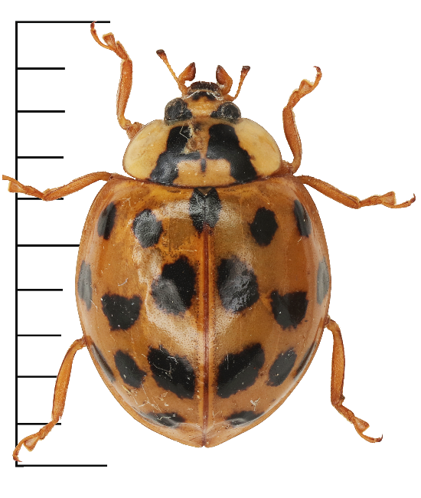
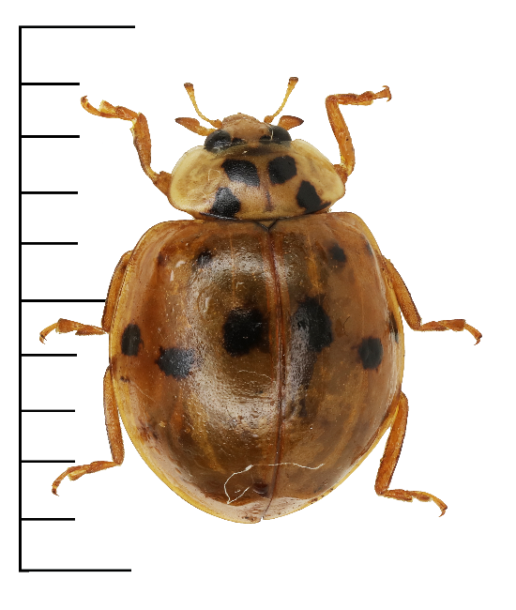
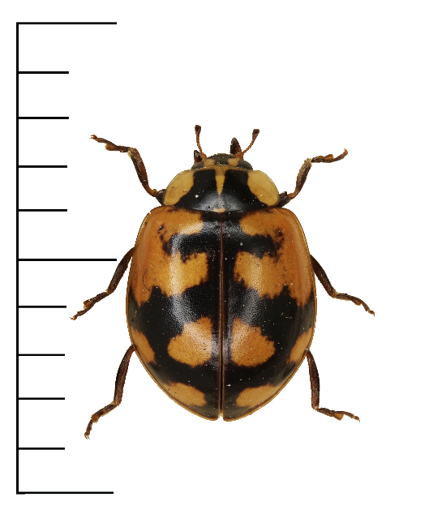
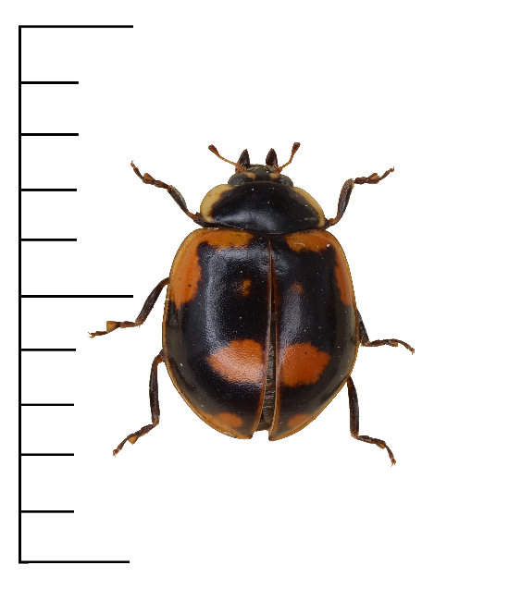
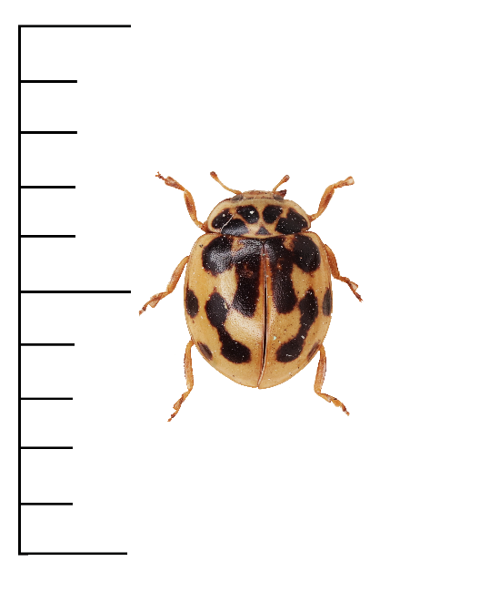
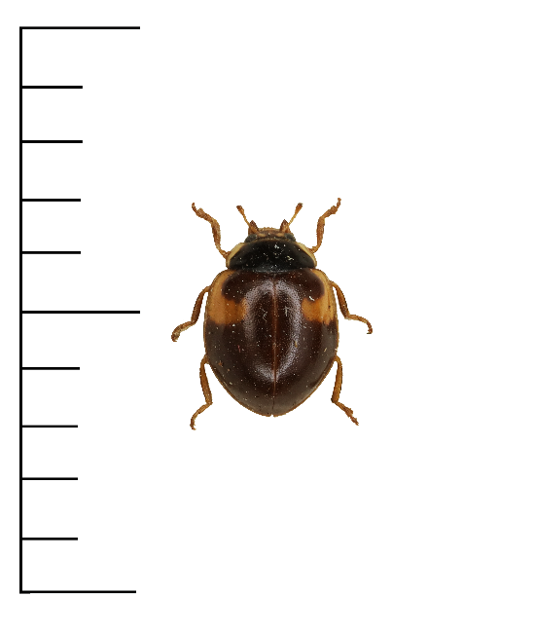
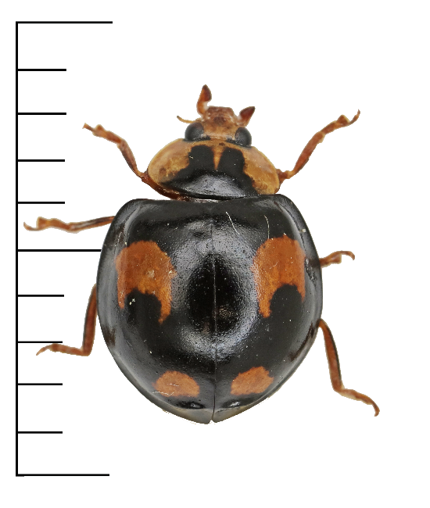
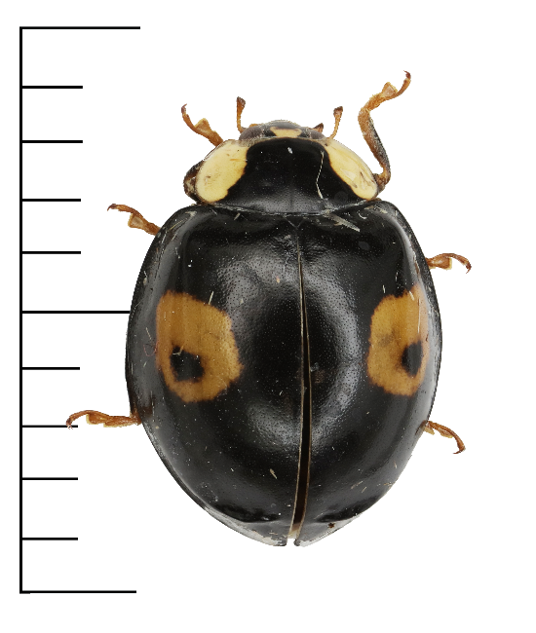
Common ladybird variations
Grouping and classifying
2-spot ladybirds
10-spot ladybirds
Harlequin ladybirds

Slide 10
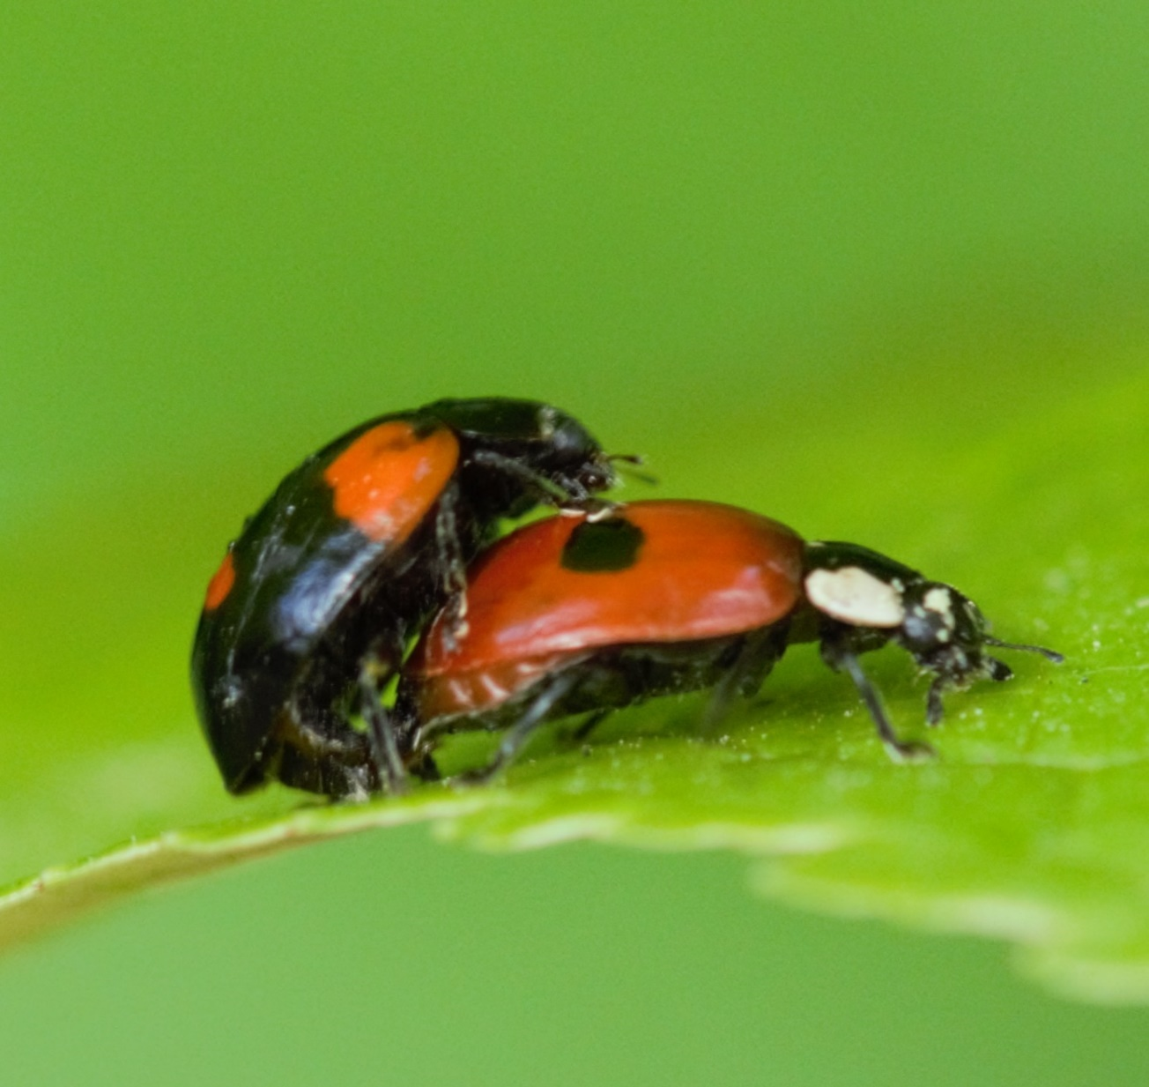
Branching key challenge
Grouping and Classifying
One way scientists identify that animals are the same species is by observing whether they can reproduce together.
By looking closely, it is often possible to find other features they have in common.
For example, 2-spot ladybirds have different shell patterns, but they all have black or dark brown legs.
2-spot ladybirds mating.
Notes:
Use the 5 extra cards for this activity. Card numbers (xx – 11) to (xx – 15).
The aim of this activity is to demonstrate that there is variation within a species. With experience, scientists learn which features are less variable in each species and use these features for identification. In ladybirds this is often a combination of size, leg colour, and pattern on the thorax (the segment just behind the head).
Often scientists will need to use microscopes to inspect tiny features.
Sometimes even experienced scientists can't identify something just by looking at it and they will need to study the animal's DNA to tell species apart.

Slide 11
Branching key challenge
Grouping and Classifying
Look at the 2-spot, 10-spot, and harlequin ladybirds for other features which they have in common.
Change your key to make it easier to use or more accurate.
Notes:
Use the 5 extra cards for this activity. Card numbers (xx – 11) to (xx – 15).
The aim of this activity is to demonstrate that there is variation within a species. With experience, scientists learn which features are less variable in each species and use these features for identification. In ladybirds this is often a combination of size, leg colour, and pattern on the thorax (the segment just behind the head).
Often scientists will need to use microscopes to inspect tiny features.
Sometimes even experienced scientists can't identify something just by looking at it and they will need to study the animal's DNA to tell species apart.

Slide 12
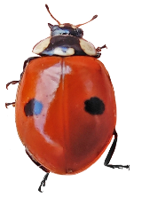
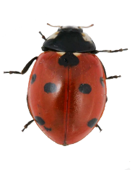
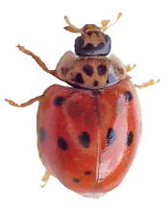
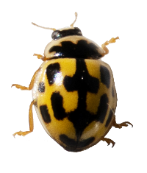
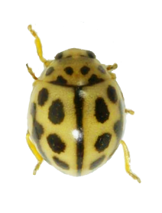
 | Common name | Scientific name | Size | Identification features
 | 2-spot | Adalia bipunctata | 3-5mm | Variable patterning Small size Black legs
 | 7-spot | Coccinella septempunctata | 5-8mm | Consistent patterning Large size Black legs
 | 10-spot | Adalia decempunctata | 3.5-4.5mm | Variable patterning Small size Orange legs
 | 14-spot | Propylea quattuordecimpunctata | 4-5mm | Consistent patterning Square spots
 | 16-spot | Tytthaspis sedecimpunctata | 2-3mm | Consistent patterning Very small

Slide 13
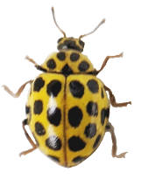
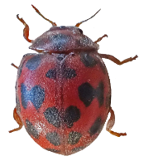
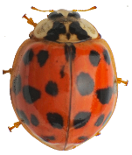
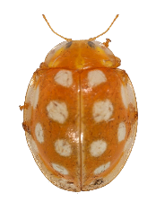
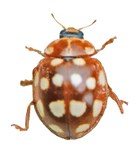
 | Common name | Scientific name | Size | Identification features
 | 22-spot | Psyllobora vigintiduopunctata | 3-4mm | Consistent patterning Thin or no black line between elytra
 | 24-spot | Subcoccinella vigintiquattuorpunctata | 3-4mm | Consistent patterning Hairy body
 | Harlequin | Harmonia axyridis | 8-10mm | Variable patterning Large size Brown legs
 | Orange | Halyzia sedecimguttata | 5-6mm | Consistent patterning Translucent fringe around body Yellow/orange legs
 | Cream spot | Calvia quattuordecimguttata | 4-6mm | Consistent patterning Darker orange/brown legs

Slide 14
Checking understanding

Slide 15
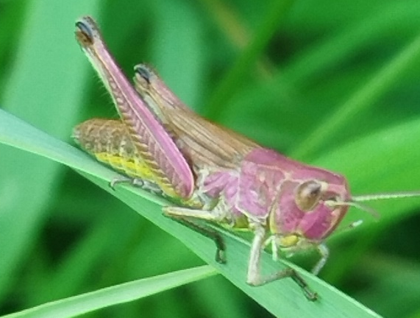
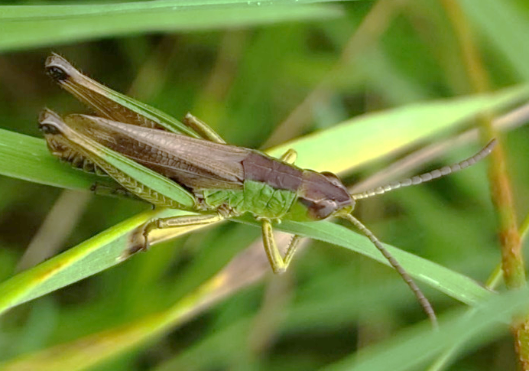
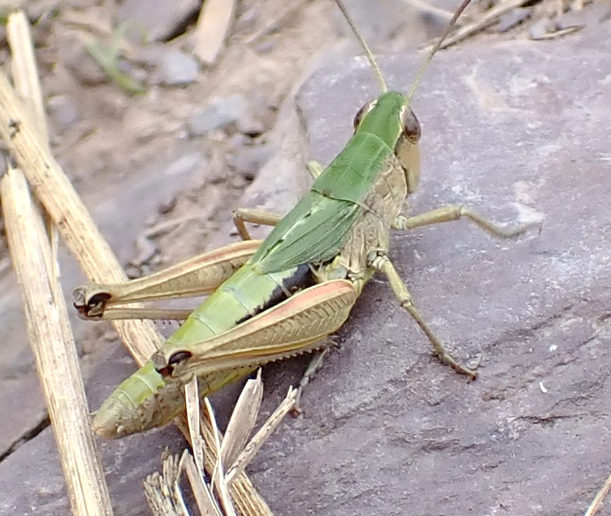
Are these grasshoppers the same species?
Grouping and Classifying
I don’t know. I need to know what features are important for this species.
No. These pictures don’t match, so they are different species.
Yes. They are the same species, just different colours.
Notes:
The three images are all meadow grasshoppers. This species can be many different colours. However they all have lines on the sides of the thorax that are almost parallel, and their wings do not have a white stripe. The 2nd response in the concept cartoon is technically correct, but the first response demonstrates understanding of the key learning points.
Discussion demonstrating understanding of key learning points should include:
The fact that there can be variation within a species. So, being different colours doesn’t necessarily mean they are different grasshopper species.
Similarities or differences in specific features. This shows awareness that they should be looking for key features rather than matching the whole animal.
If students have not been introduced to the different grasshopper species and their key characteristics, then concluding that they do not know because they don’t have enough information demonstrates students’ metacognitive thinking.

Slide 16
We hope you found this resource useful!
Send your feedback to school-bookings@nhm.ac.uk
This resource was produced with support from Evolution Education Trust.

